Slide 1


Analysis of Rental Patterns & Film Popularity from a Database

Slide 2
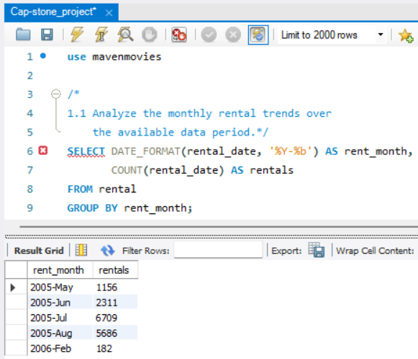
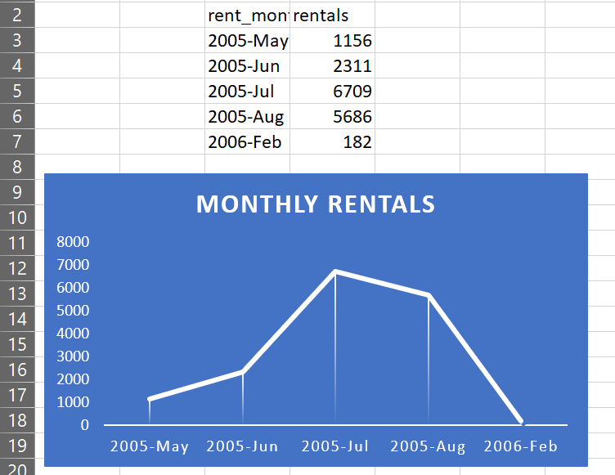
1.1 Analyze the monthly rental trends over the available data period.
A) The month “July” of 2005 see’s the more rentals than other months, next to it is “August” of 2005 and the other months are on lower side.

Slide 3
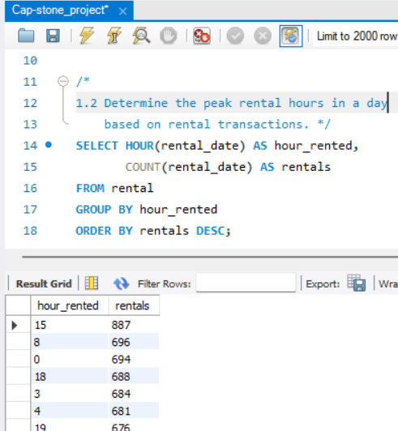
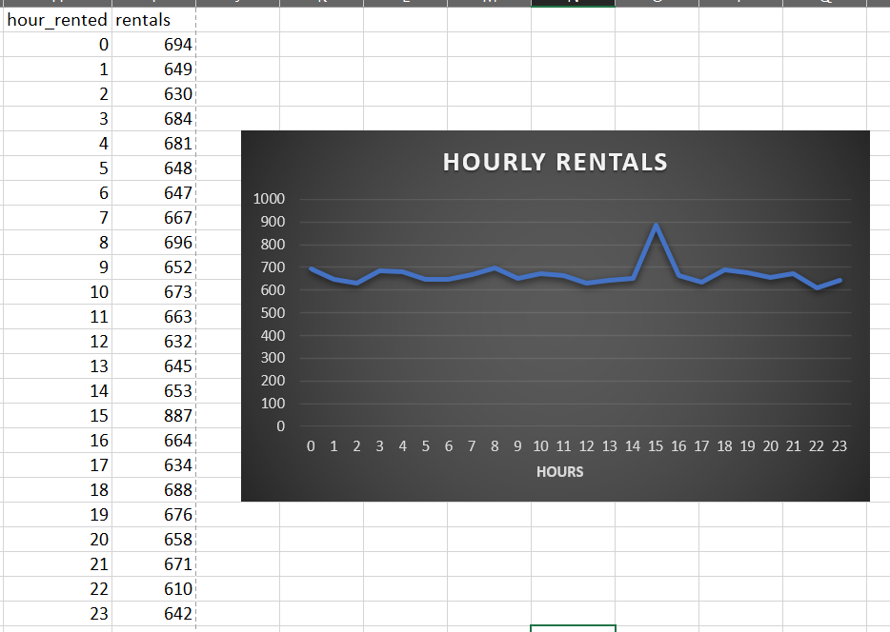
1.2 Determine the peak rental hours in a day based on rental transactions.
A) The peak rental hours in a day are mid-afternoon i.e; 3PM.

Slide 4
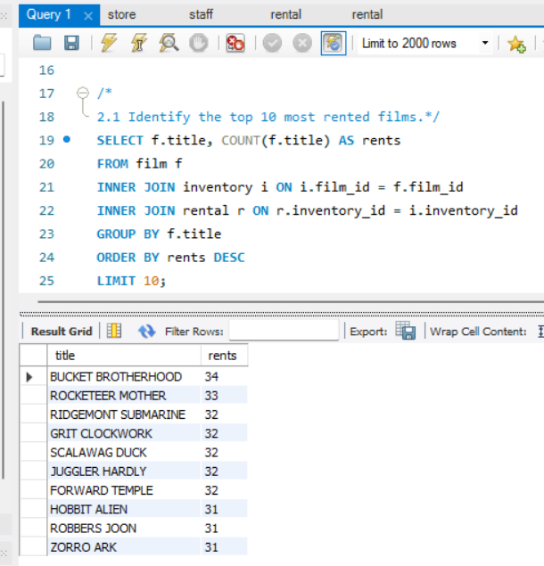
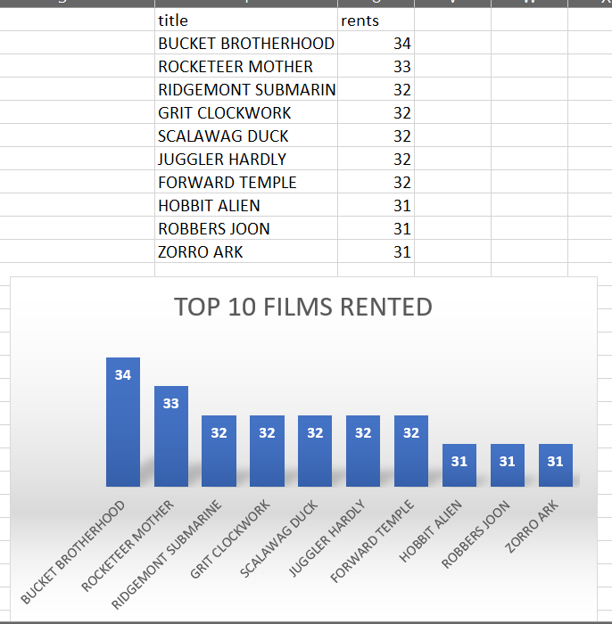
2.1 Identify the top 10 most rented films.
A) These are the top 10 and out these Bucket Brotherhood is the leading one

Slide 5
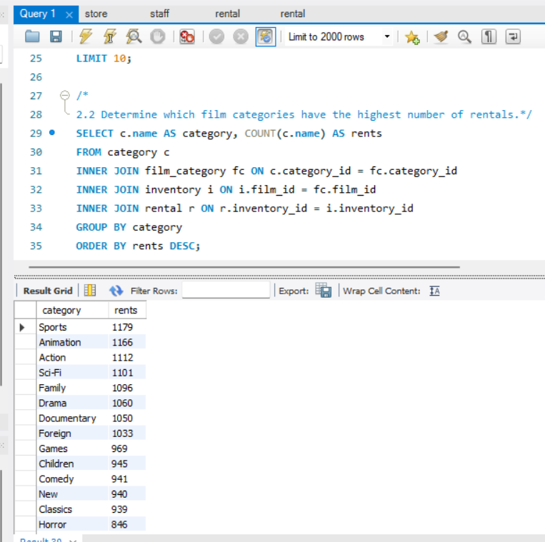
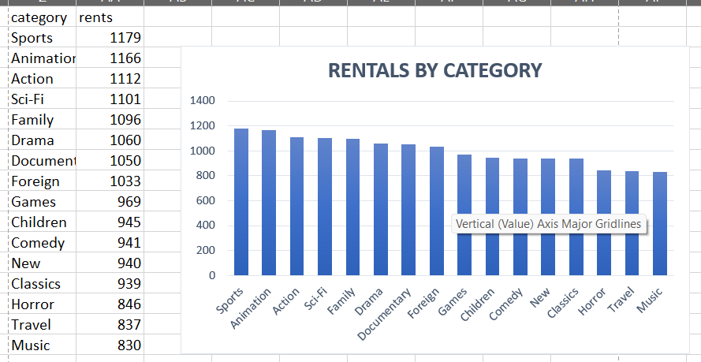
2.2 Determine which film categories have the highest number of rentals.
A) The Sports category is in 1st and then after Animation,Action,Sci-Fi categories.

Slide 6
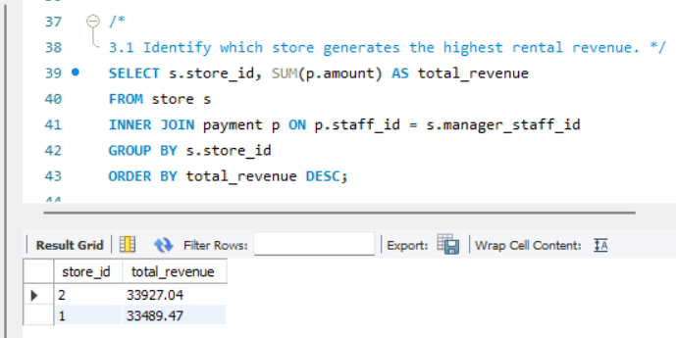
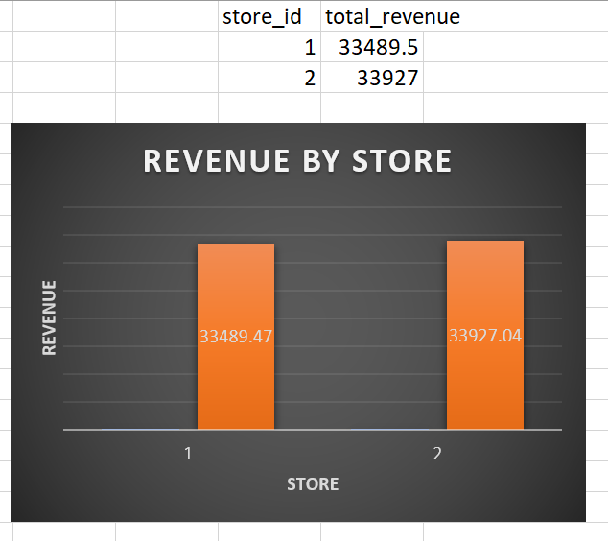
3.1 Identify which store generates the highest rental revenue.
A) The store_id with 2 generates the highest rental revenue.

Slide 7
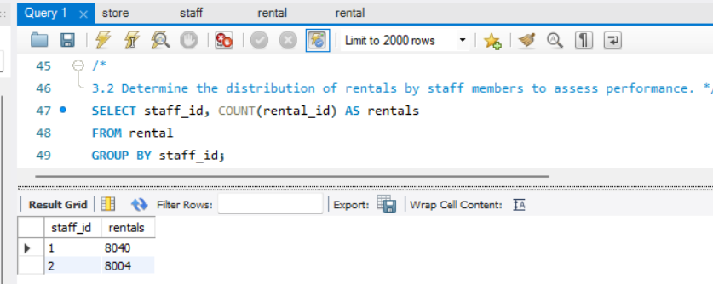
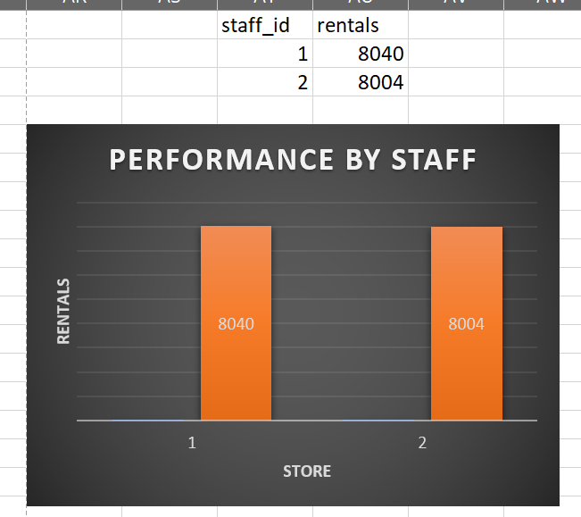
3.2 Determine the distribution of rentals by staff members to assess performance.
A) The staff person with id 1 performs well, by the distribution of total 8040 rentals.

